Slide 1
RESTAURANT RECOMMENDER SYSTEM
Restaurant recommender system is a machine learning model, developed to demonstrate as a capstone project to IBM through coursera.

Slide 2
Methodology
Recommender System
Machine learning
Exploratory analysis
Inferential analysis

Slide 3
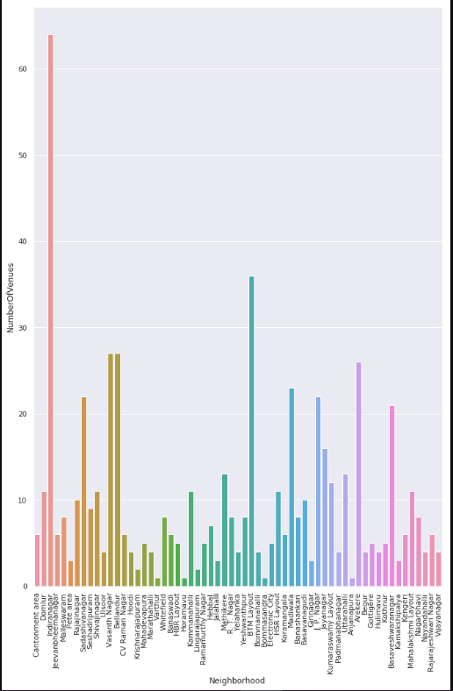
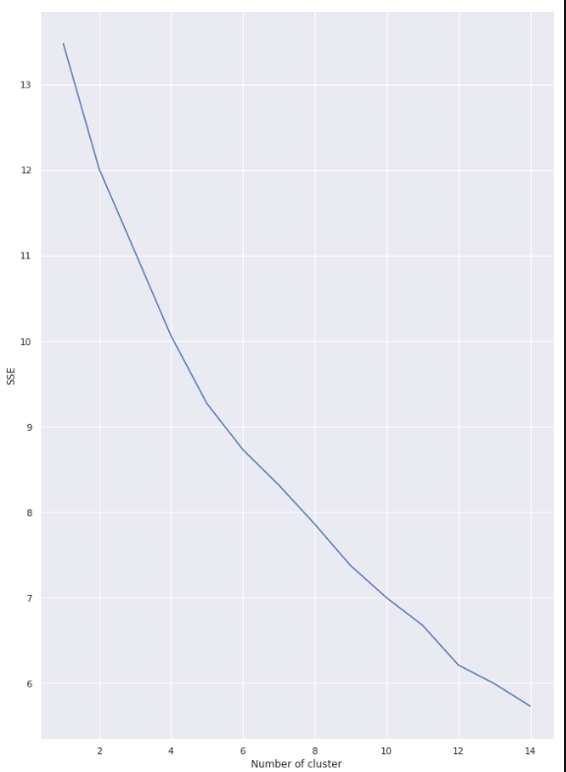

Slide 4
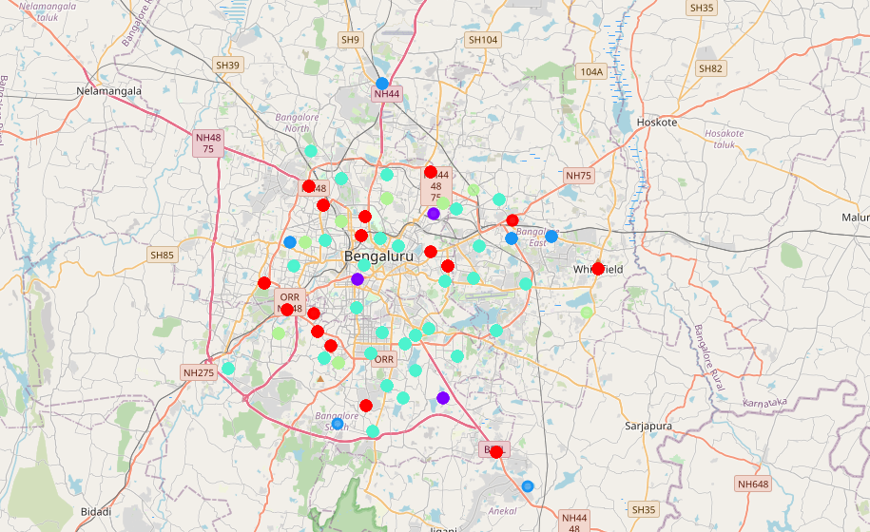

Slide 5
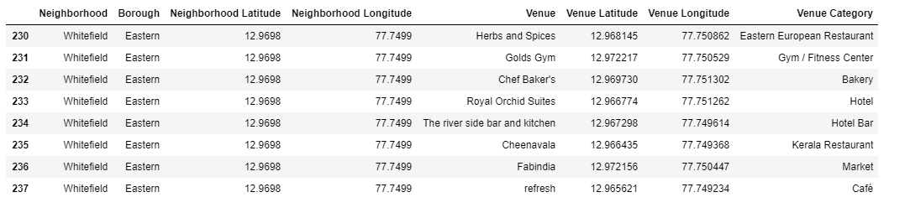
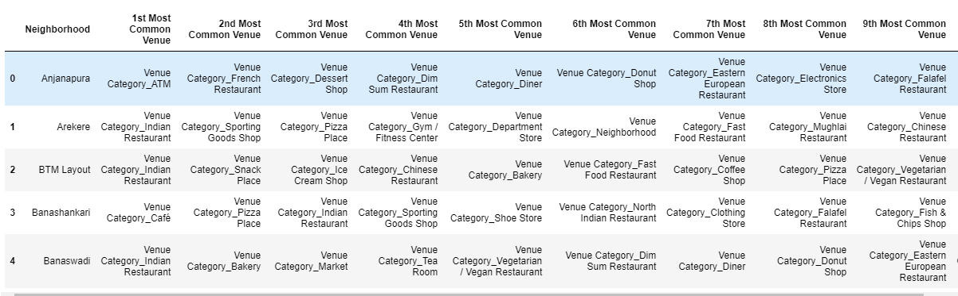

Slide 6
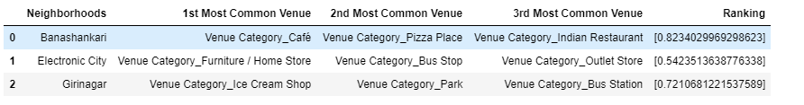

Slide 7
Thank you
Ashish kumar

